Slide 1


EC2
Sameer Zulfi

Slide 2
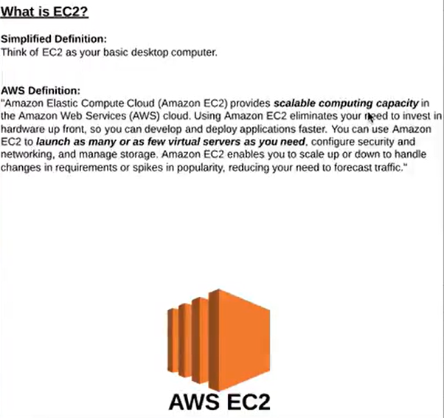
EC2 = Elastic Compute Cloud

Slide 3
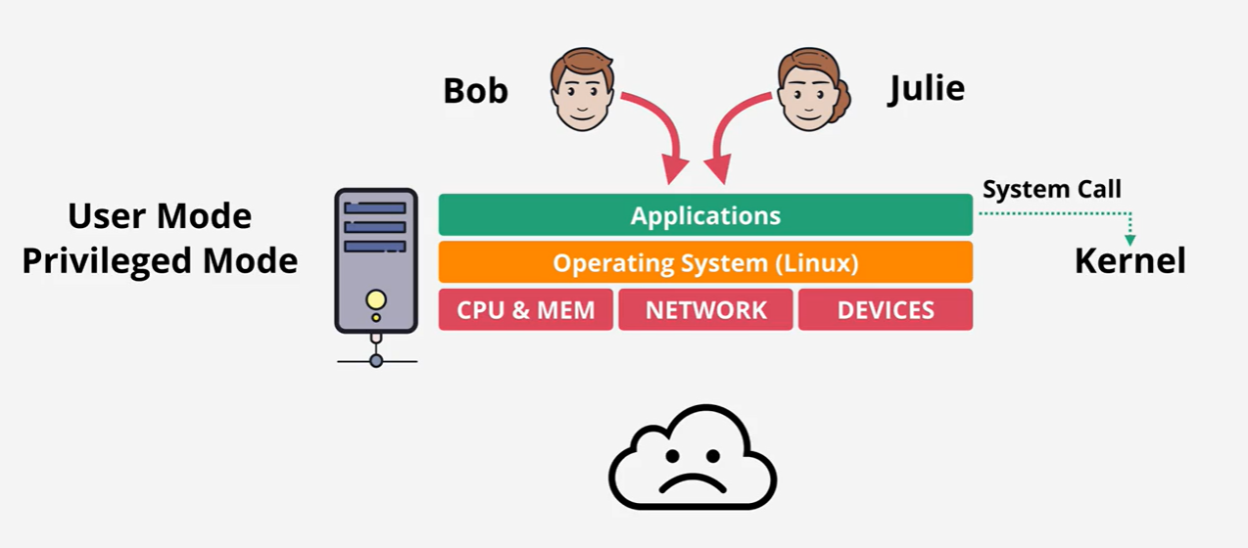
Intro Level to Virtualization
Before Virtualization :

Slide 4
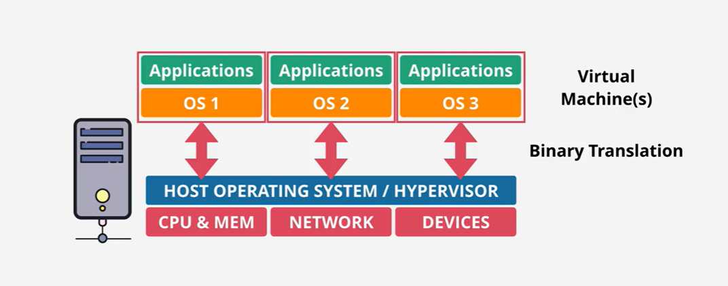
Virtualization
Emulated Virtualization / Software Virtualization

Slide 5
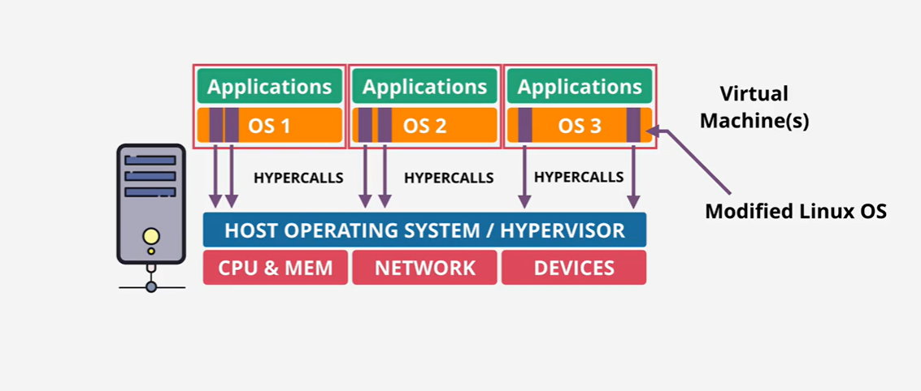
Virtualization
Para-Virtualization

Slide 6
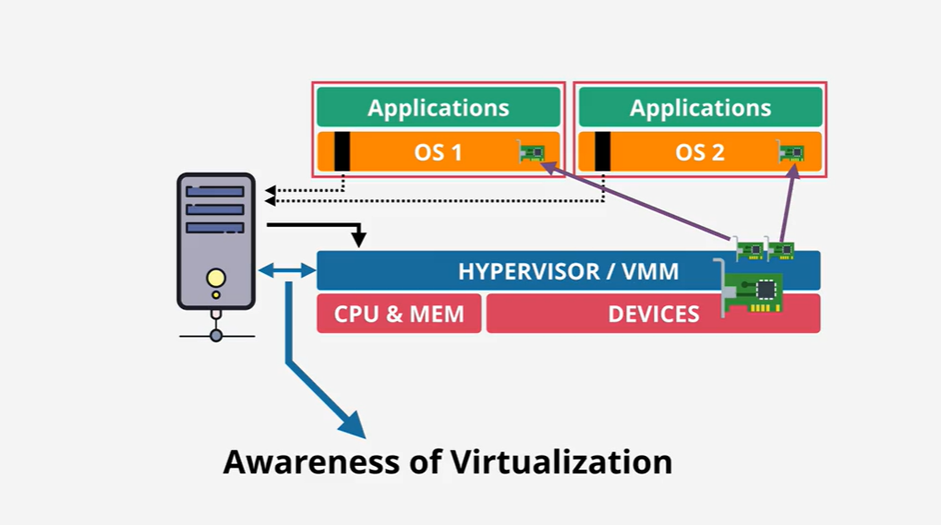
Virtualization
Hardware Assisted Virtualization

Slide 7
AWS Virtualization Types
ParaVirtual – PV
Software Virtualization
The following previous generation instance types support PV AMIs: C1, C3, HS1, M1, M3, M2, and T1. Current generation instance types do not support PV AMIs.
Hardware Virtual Machine – HVM
Latest generation and recommended in terms of boot times.
Virtualized set of hardwares
It emulates some or all of the underlying hardware that is presented to the guest
All current generation instance types support HVM AMIs.

Slide 8
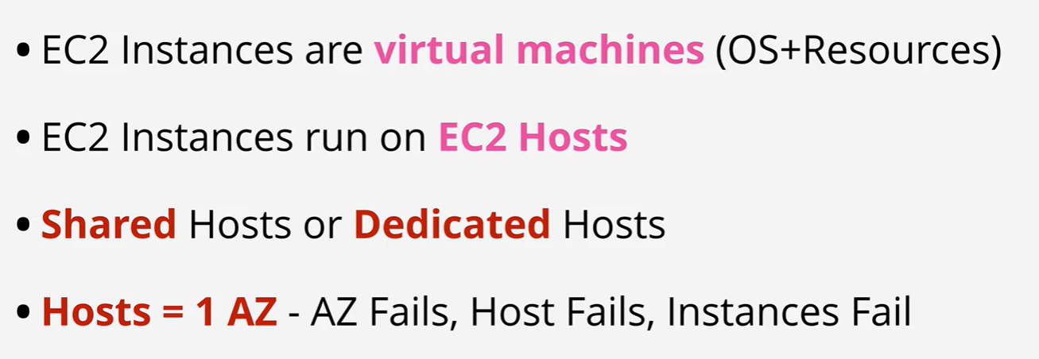
EC2 Architecture

Slide 9
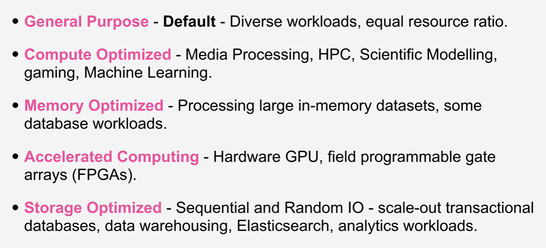
EC2 Categories

Slide 10
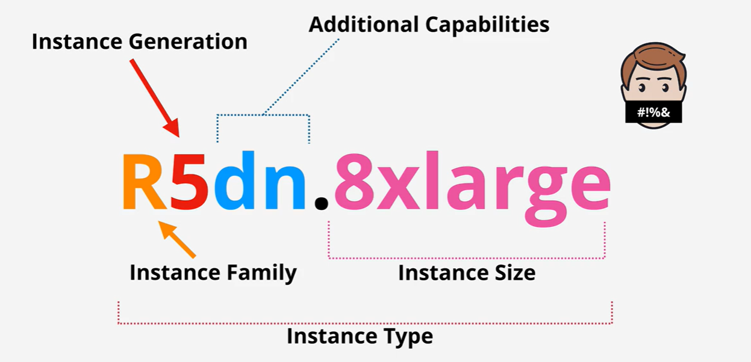
Decoding EC2 Types

Slide 11
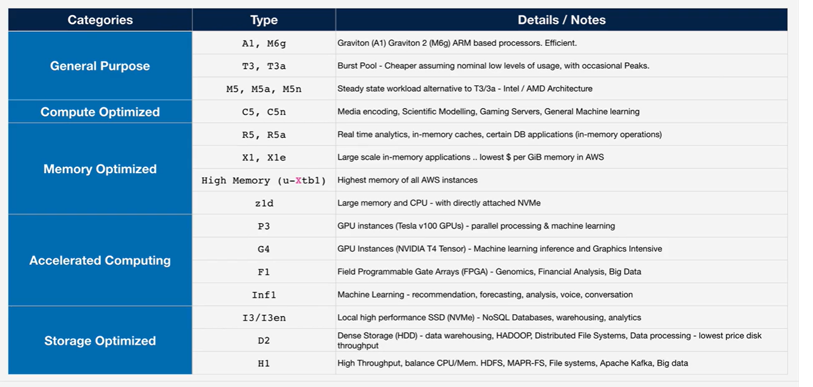
EC2 Instance Types

Slide 12
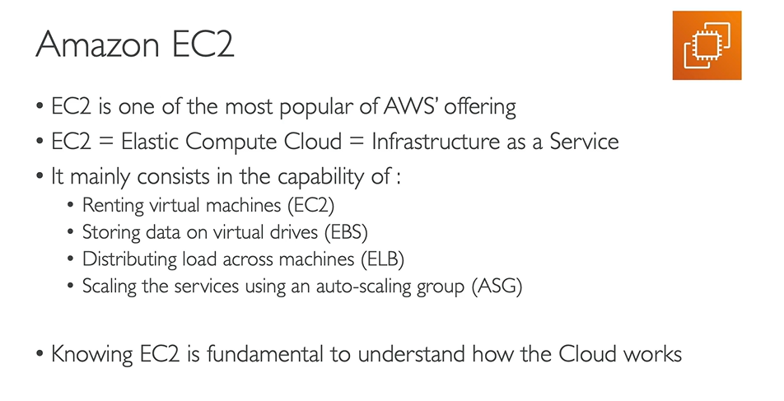
Amazon EC2

Slide 13
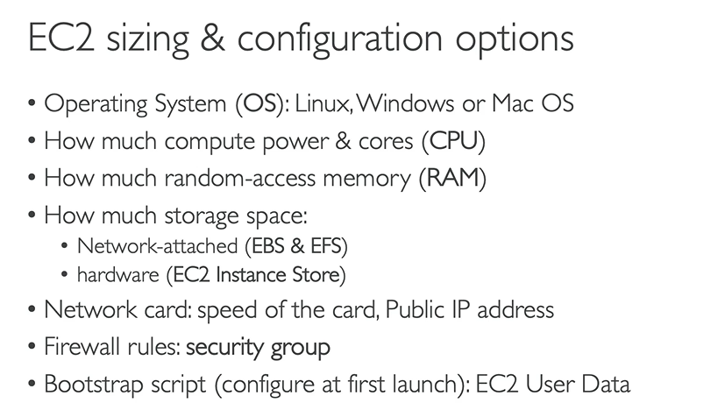
Amazon EC2

Slide 14
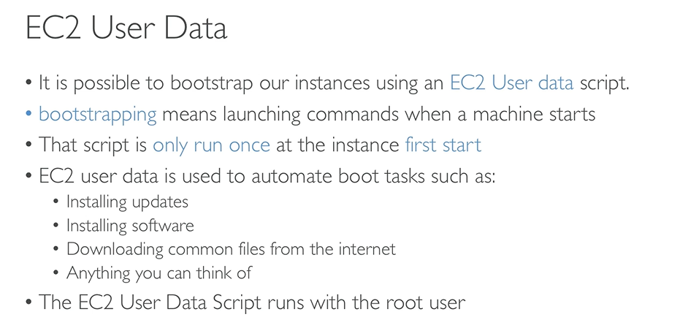
EC2 User Data

Slide 15
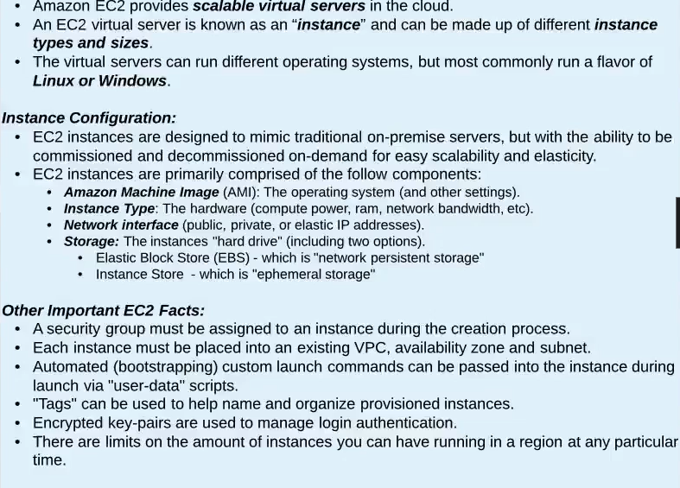
EC2 Essentials

Slide 16
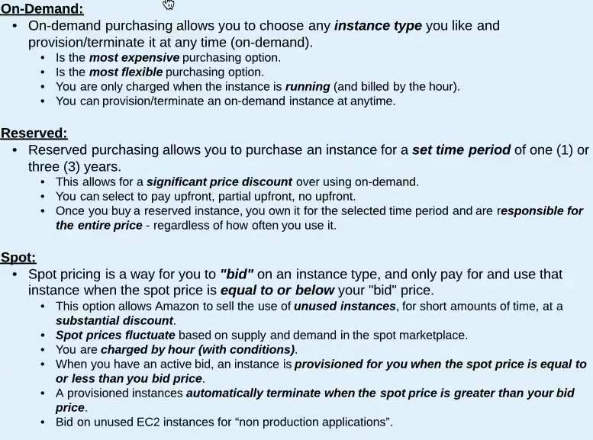
EC2 Purchasing Options

Slide 17
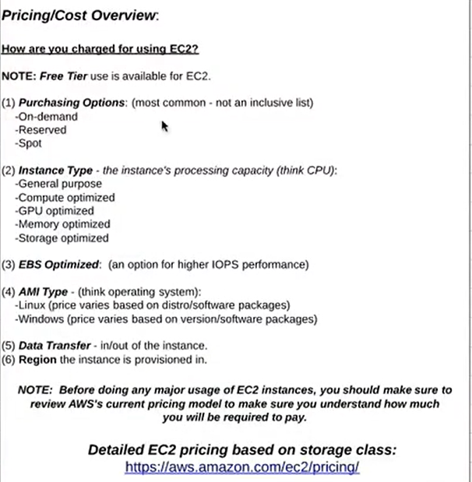
Pricing/Cost Overview

Slide 18
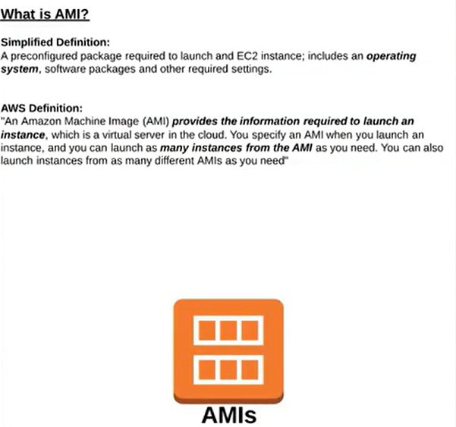
AMI – Amazon Machine Image

Slide 19
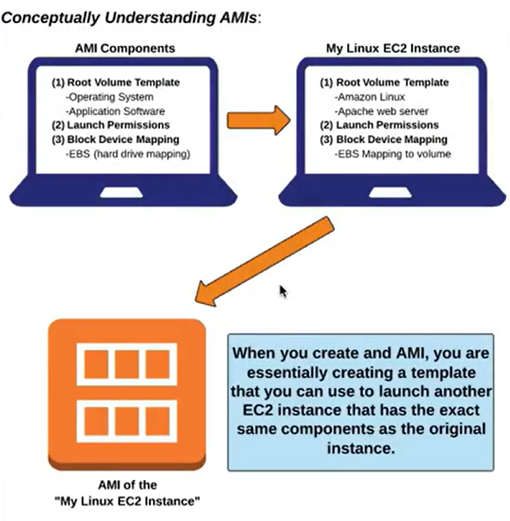
AMI Concept

Slide 20
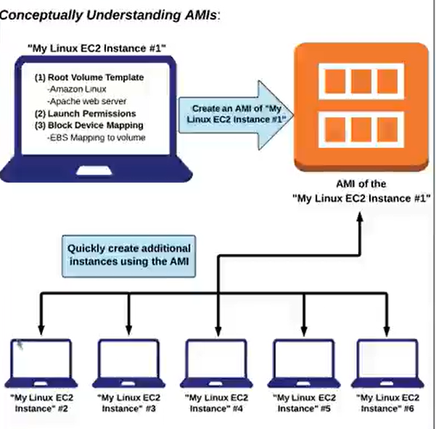
AMI Concept

Slide 21
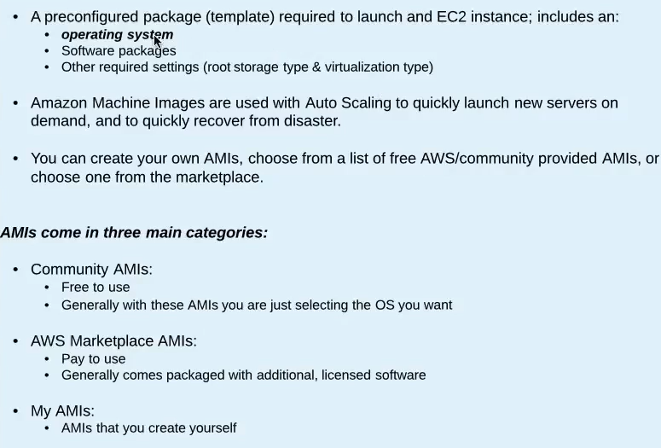
EC2 AMIs and Virtualization

Slide 22
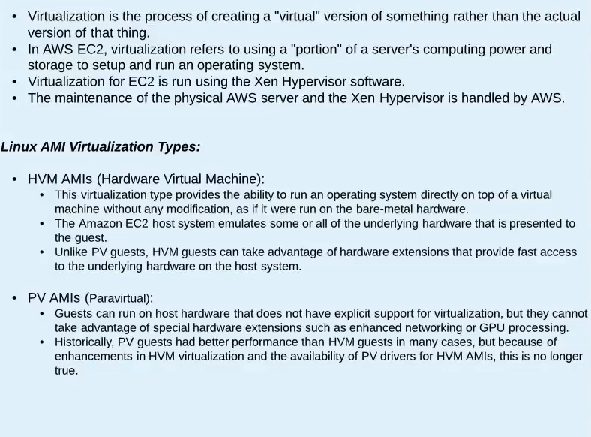
EC2 AMIs and Virtualization

Slide 23
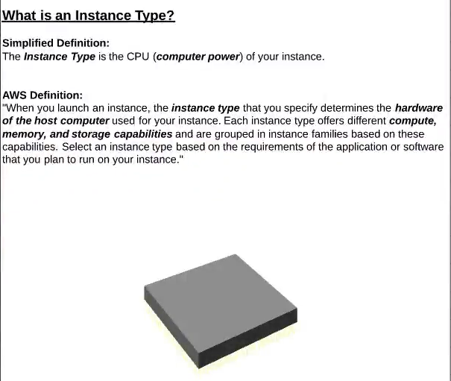
Instance Type

Slide 24
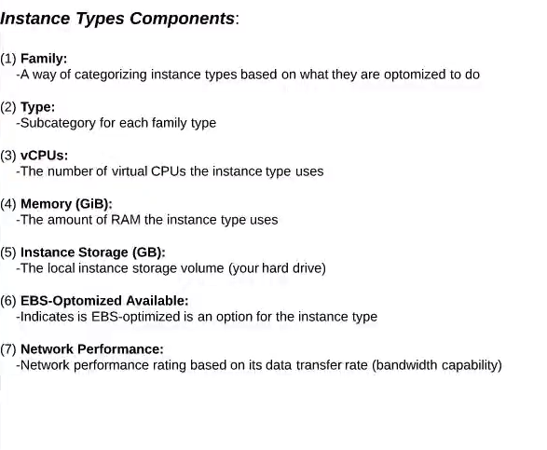
Instance Types
https://aws.amazon.com/ec2/instance-types/
Amazon EC2 Instance Comparison (vantage.sh)

Slide 25
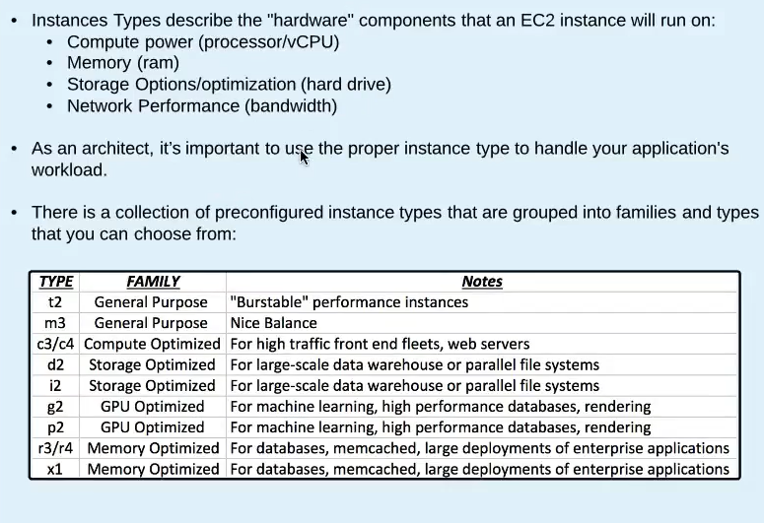
EC2 Instance Types

Slide 26
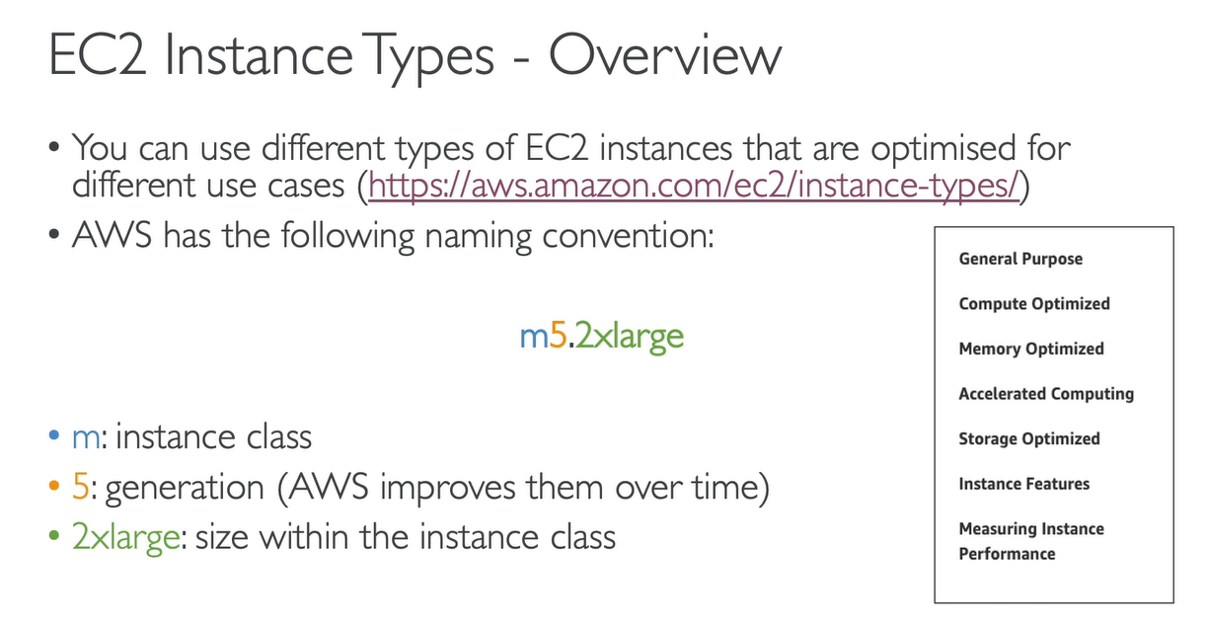
EC2 Instance Type

Slide 27
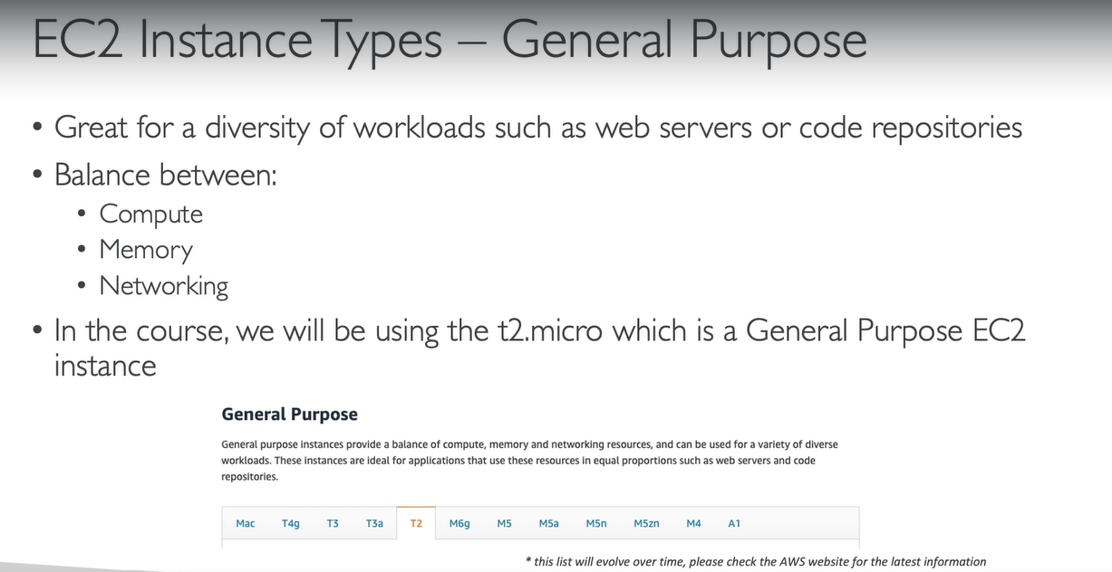
EC2 Instance Type

Slide 28
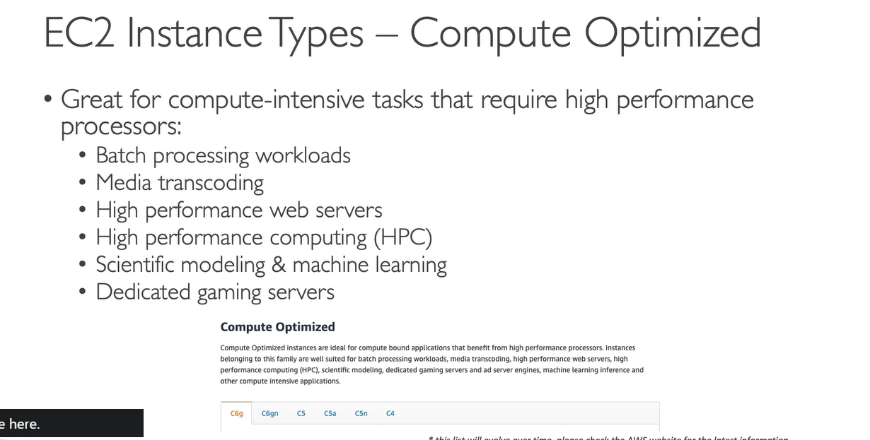
EC2 Instance Type

Slide 29
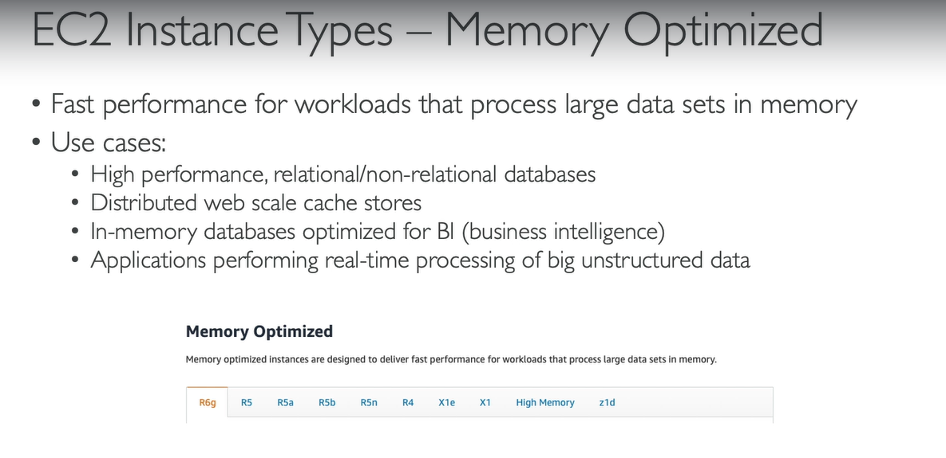
EC2 Instance Type

Slide 30
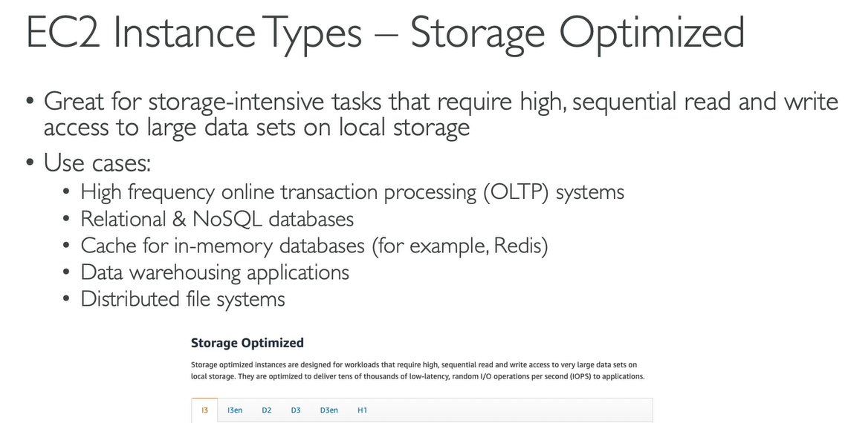
EC2 Instance Type

Slide 31
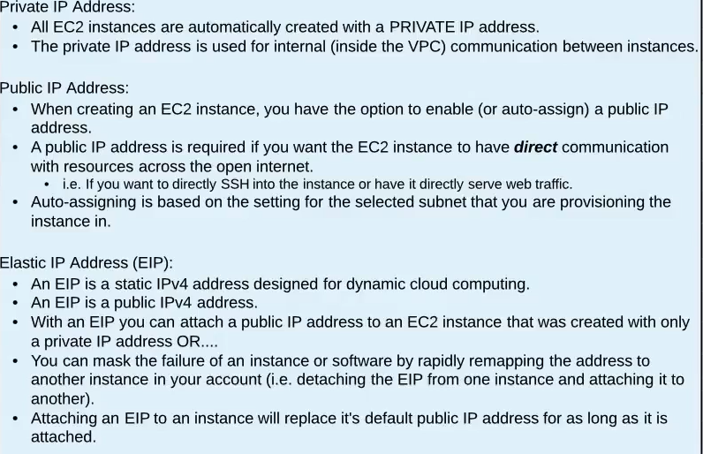
Public, Private and Elastic IP Address

Slide 32
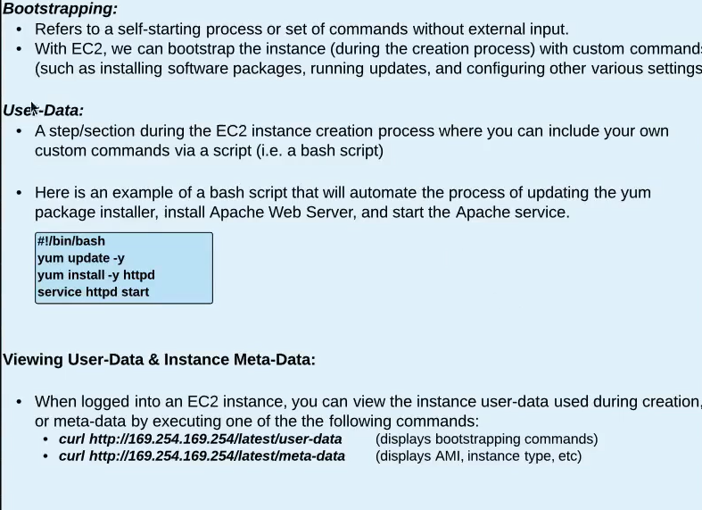
EC2 BootStrapping, User-Data and Meta-Data

Slide 33
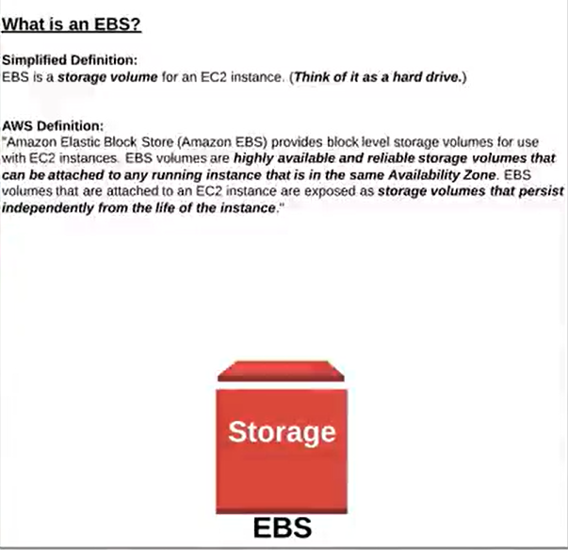
EBS – Elastic Block Store

Slide 34
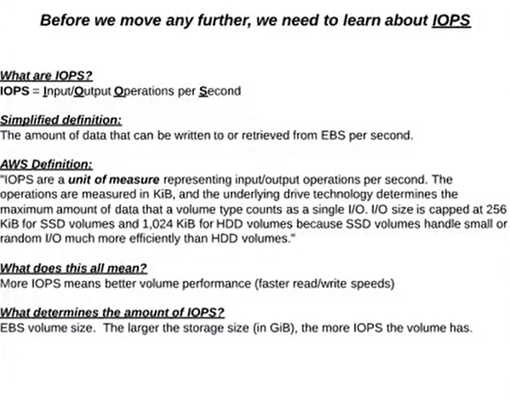
EBS Concepts

Slide 35
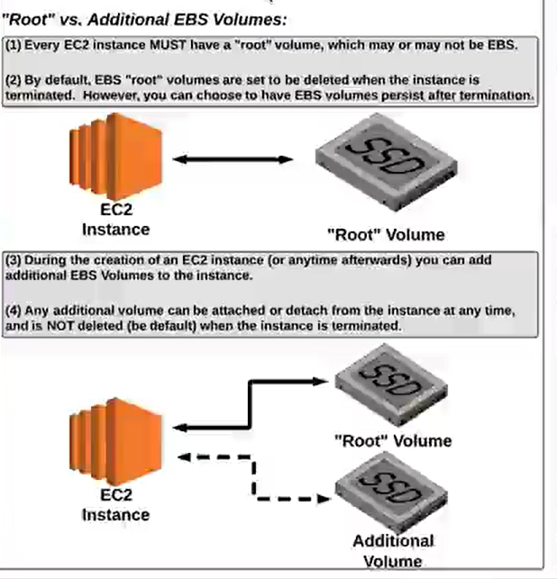
Root vs Additional EBS Volumes

Slide 36
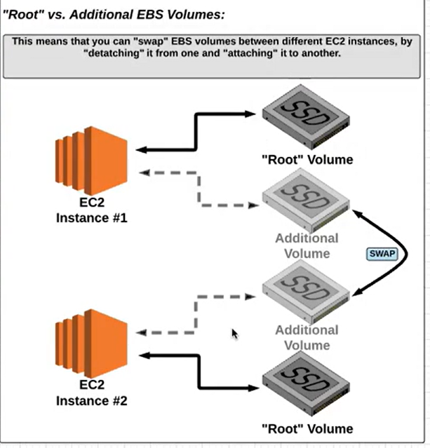
Root vs Additional EBS Volumes

Slide 37
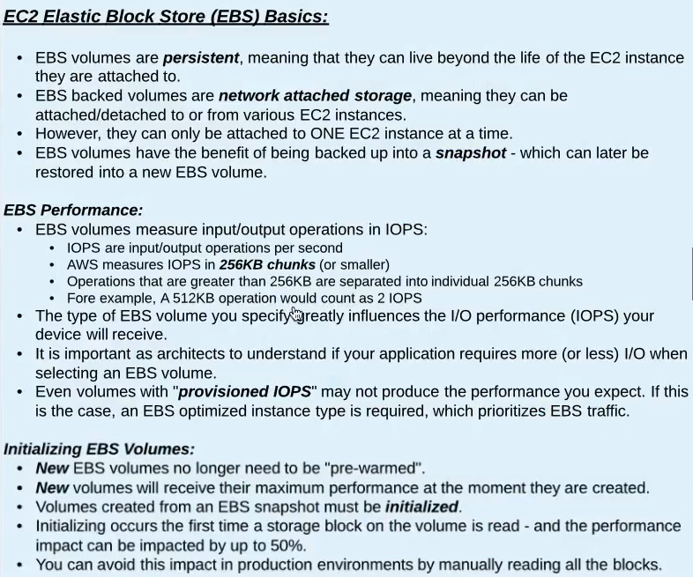
EC2 Storage Options

Slide 38
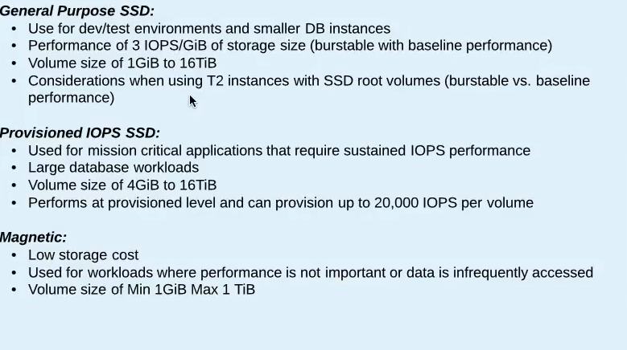
EBS types

Slide 39
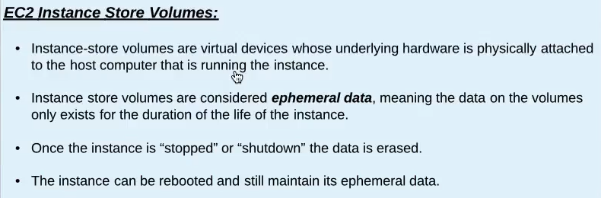
Instance Store

Slide 40
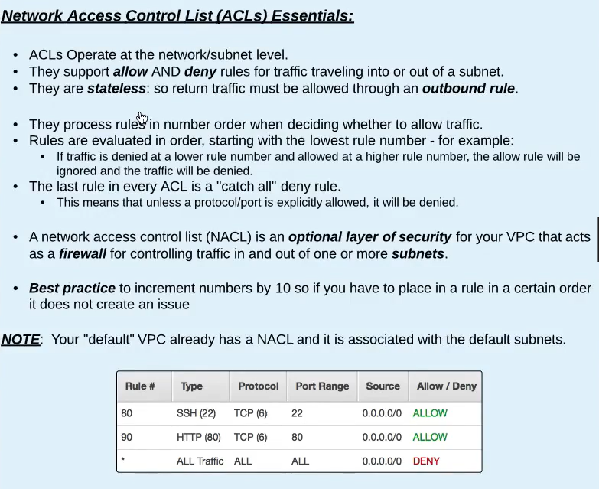
NACL

Slide 41
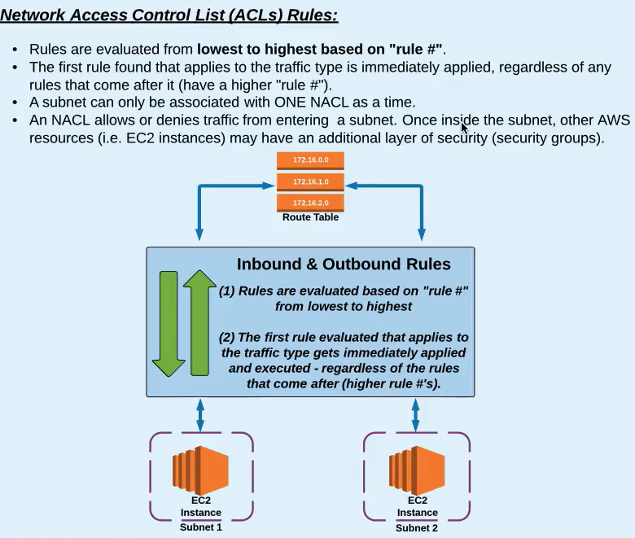
NACL

Slide 42
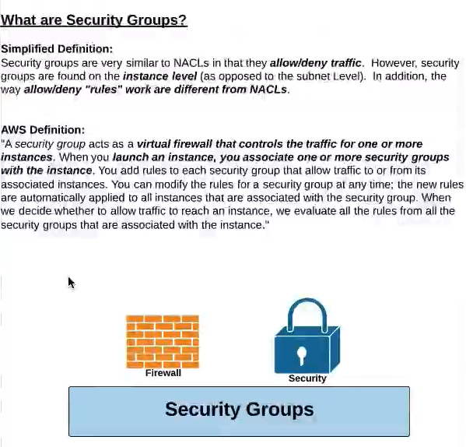
Security Groups

Slide 43
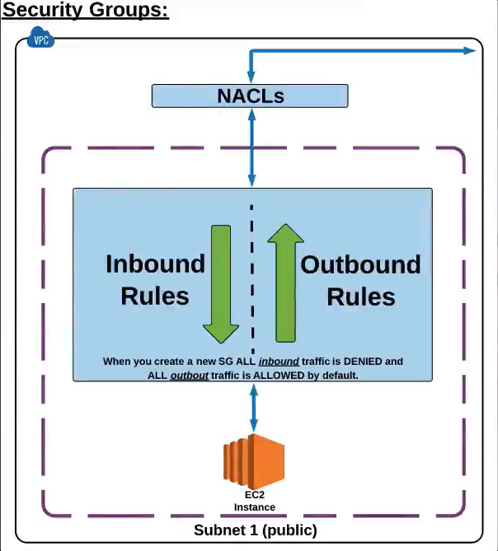
Security Groups

Slide 44
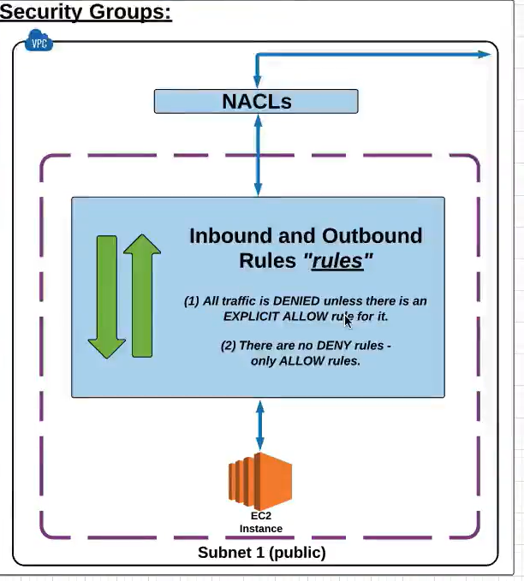
Security Groups

Slide 45
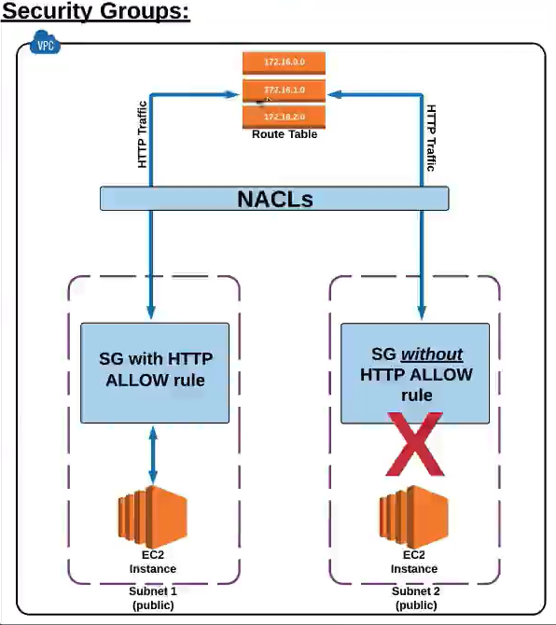
Security Groups

Slide 46
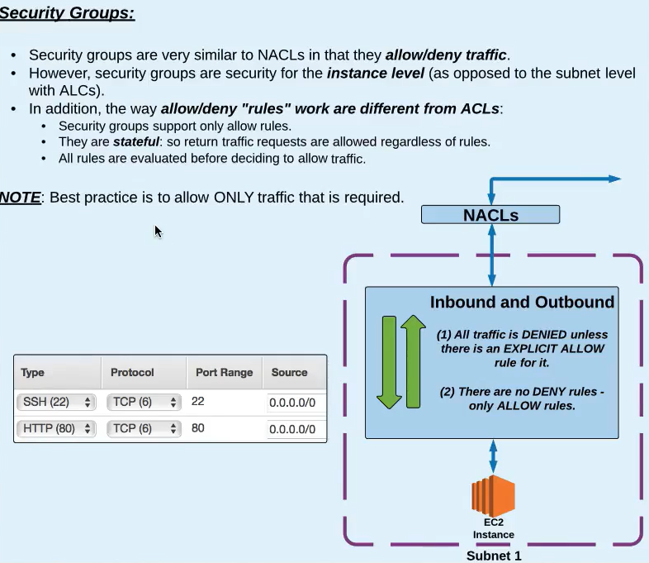
Security Groups

Slide 47
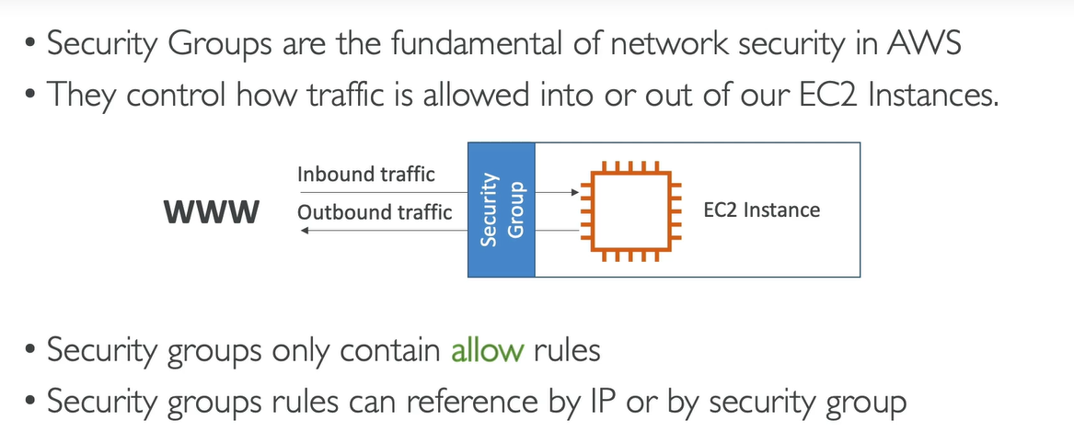
Security Groups

Slide 48
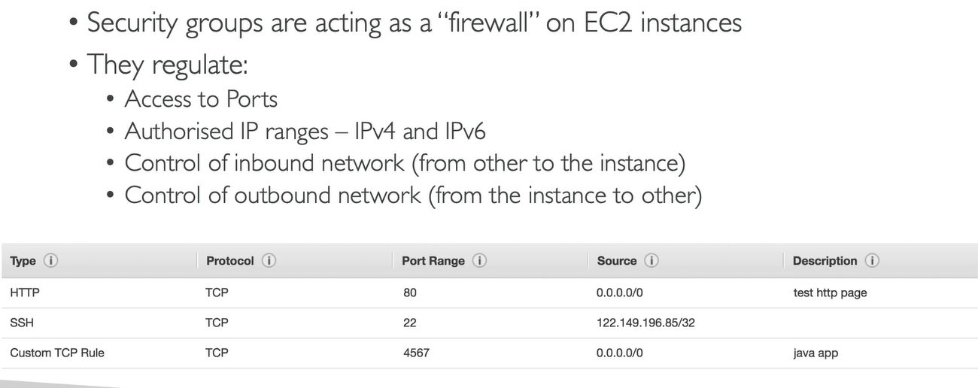
Security Groups

Slide 49
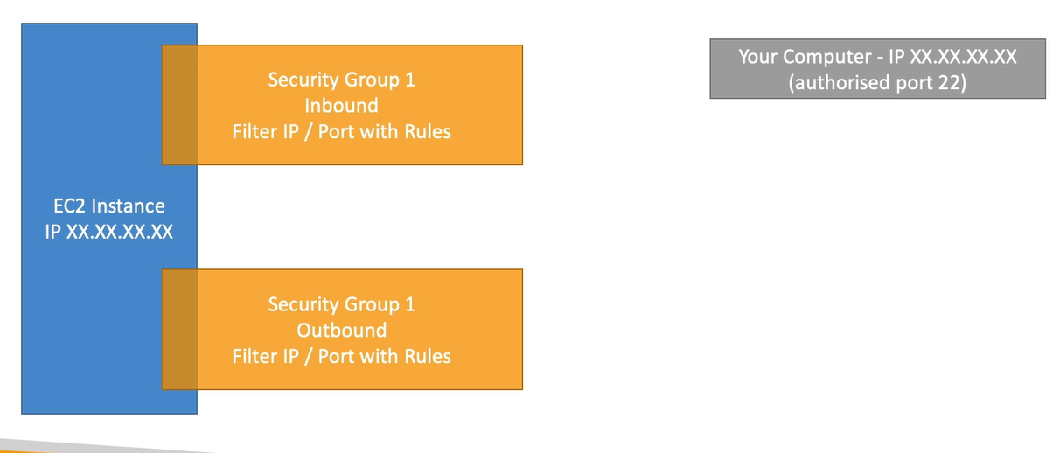
Security Groups Diagrams

Slide 50
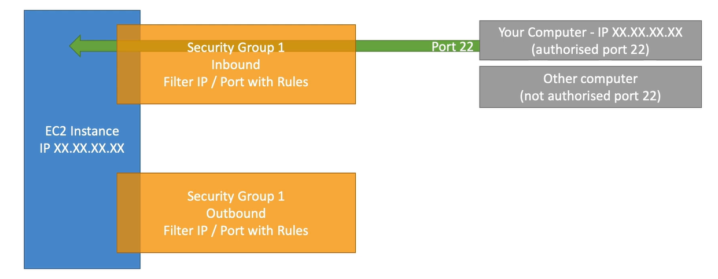
Security Groups Diagrams

Slide 51
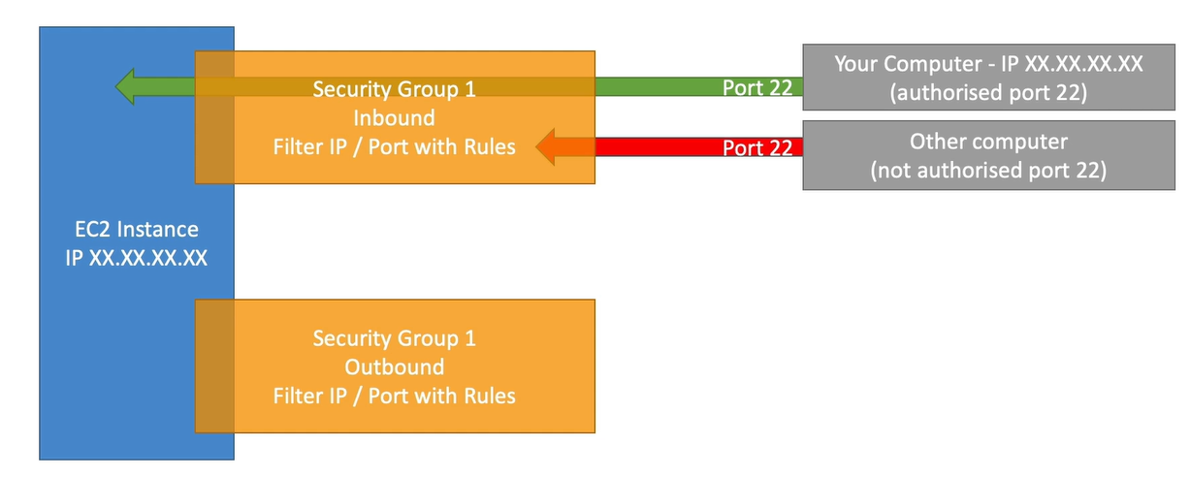
Security Groups Diagrams

Slide 52
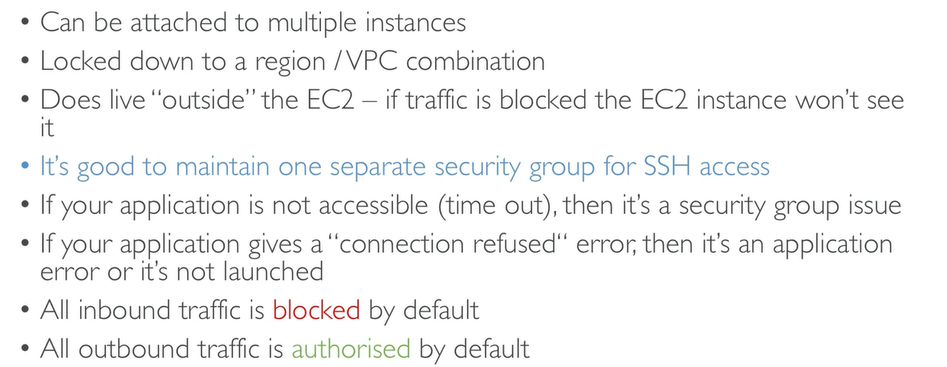
Security Groups good to know

Slide 53

Referencing other Security Groups

Slide 54

Classic Ports to know

Slide 55

EBS Snapshots

Slide 56

EBS Snapshots

Slide 57

EC2 Placement Groups

Slide 58

EFS – Elastic File Systems

Slide 59

EC2 Troubleshooting Scenarios

Slide 60

IP Addressing

Slide 61

IP Addressing

Slide 62

IP Addressing

Slide 63

Launch and connect to an ec2 instance

